Slide 1
Scientific literacy & inquiry (SL&I)
SEMESTER 3
August 26, 2026 Session 3
Jennifer A. Campbell, PhD, MPH
Course Director

Slide 2
Special topics in Research
Survival Analysis Part 1

Slide 3
SLI Session | Date | Time Start | Time End | Topic | Instructor | Graded Assessments | USMLE Alignment
Session 1 | 07/29/26 | 1:00 PM | 2:30 PM | Special Topics in Research Part I - Behavioral Economics | Dr. Ekwunife | Active Learning | Epidemiology/population health: Survival Analysis Interpretation
Session 2 | 08/05/26 | 1:00 PM | 2:30 PM | Special Topics in Research Part II - Behavioral Economics | Dr. Ekwunife | Active Learning + UB Learns 3 Attempt Quiz | Epidemiology/population health: Survival Analysis Interpretation
Session 3 | 08/26/26 | 1:00 PM | 2:30 PM | Special Topics in Research Part I - Survival Analysis | Dr. Fraser | Active Learning | Epidemiology/population health: Survival Analysis Interpretation
Session 4 | 09/09/26 | 1:00 PM | 2:30 PM | Special Topics in Research Part II - Survival Analysis | Dr. Fraser | Active Learning + UB Learns 3 Attempt Quiz | Health care policy and economics
Session 5 | 10/07/26 | 1:00 PM | 2:30 PM | Biostats | Dr. Sharma | Active Learning | Distributions of Data; Correlations, Regression, Uses and Interpretation
Session 6 | 10/21/26 | 1:00 PM | 2:30 PM | Biostats | Dr. Sharma | Active Learning + UB Learns 3 Attempt Quiz | Distributions of Data; Correlations, Regression, Uses and Interpretation
Session 7 | 11/04/26 | 1:00 PM | 2:30 PM | Final exam |  | Final exam

Slide 4
Introduction to survival analysis
PART I
Raphael A. Fraser, PhD

Slide 5
Learning Objectives
Define survival analysis and explain its relevance in clinical research and medical decision-making.
Identify and describe censored data, including right-censoring, and interpret their implications in survival studies.
Explain the survivor function, including its mathematical definition, clinical interpretation, and graphical representation
Interpret the hazard function, including its use in describing the instantaneous risk of an event and its relationship to the survivor function
Describe the primary goals of survival analysis, including estimation of time-to-event outcomes, comparison of survival between groups, and evaluation of prognostic factors

Slide 6
Case
Maria R. is 43 years old when she is diagnosed with stage II triple-negative breast cancer (TNBC), a subtype known for aggressive behavior and a meaningfully higher risk of recurrence than other breast cancer subtypes. Her oncologist tells her about a clinical trial she may be eligible for: KEYNOTE-522, a phase 3, double-blind, placebo-controlled trial run at 183 sites across 21 countries, testing whether adding the immunotherapy drug pembrolizumab to standard chemotherapy improves outcomes compared to chemotherapy alone.
Maria enrolls. She is randomized , by chance, in a 2:1 ratio, to one of two arms. Neither she nor her care team knows which one. She begins treatment on Day 1 of the study.
The trial ultimately enrolls 1,174 patients like Maria: 784 to pembrolizumab-chemotherapy, 390 to placebo-chemotherapy.
Its primary question is whether the pembrolizumab arm has better event-free survival (EFS) staying free of local or distant recurrence, a second primary cancer, death from any cause, or disease progression that prevents surgery, compared to the placebo arm.

Slide 7
Open Discussion
You're the trial's biostatistician.
On the day the study team locks the data and starts analyzing results, every one of the 1,174 enrolled patients is at a different point in their own story, some enrolled 4 years ago, some 8 months ago; some had an event, most (so far) haven’t.
How would you summarize each patient's outcome so that patients enrolled at different times, followed for different lengths, can still be compared fairly?

Slide 8
Case Follow-up
Maria is one of 1,174 people enrolled in KEYNOTE-522. Here's what the trial's data actually looked like for five representative participants at the time of analysis.

Slide 9
Case Follow-up
Patient | Enrolled | Last known status | What we actually know
Patient A | Month 0 | Month 14 — disease recurrence confirmed | Experienced the outcome event.
Patient B | Month 0 | Month 22 — last clinic visit, no evidence of disease; trial data-lock at Month 30 | No event observed by data-lock. Was still being actively followed.
Patient C | Month 3 | Month 11 — missed visit; unreachable despite phone/mail outreach | No event observed, but the study team has no information about her after Month 11.
Patient D | Month 6 | Month 9 — withdrew consent (relocating out of the trial's region) | No event observed. Left the study by her own choice, for reasons unrelated to her cancer.
Patient E | Month 20 | Month 26 — data-lock (only 6 months of possible follow-up) | No event observed, but she simply hasn't had much time in the study yet.

Slide 10
Open Discussion
Only Patient A had the outcome event.
The other four : B, C, D, and E all show up in the dataset with “no event observed.”
But are Patients B, C, D, and E really telling us the same thing?
What do we actually know, and not know, about each of them?
Would you feel equally confident saying each one “did well” on the trial?

Slide 11
Rationale for Survivor Analysis
Every field that studies time-to-event outcomes: oncology trials, cardiology, transplant medicine, infectious disease all run into this exact problem.
The next 2 sessions will provide the vocabulary and tools for handling it: what we mean by “censoring,” how to describe an outcome like Maria's mathematically, and how trials like KEYNOTE-522 turn stories like hers into the survival curves you'll see published in NEJM.

Slide 12
What is Survival Analysis?
Statistical method to analyze time-to-event data
Outcome: Time until an event occurs
“Event” can be: death, relapse, hospitalization, onset of a disease, etc.
Assume 1 event per person
Terminology: Time = survival time; Event = failure

Slide 13
KEYNOTE-522 (Schmid et al. 2024 NEJM)
Phase 3 double-blind RCT conducted at 183 sites in 21 countries (Europe, North America, Asia, & Latin America)
Population: 1174 patients with early-stage triple-negative breast cancer
Randomization (2:1 ratio)
Intervention: Pembrolizumab-Chemo 784 | Control: Placebo-Chemo 390
Primary Outcome: EFS—time from randomization to the first occurrence of any of the following events: local or distant recurrence, second primary cancer, death from any cause, disease progression precluding surgery
Secondary outcome: OS—time from randomization to death from any cause (in months)

Slide 14
More Examples
Leukemia patients: time in remission (weeks)
Heart transplants: time until death (months)
Disease-free cohort: time until heart disease (years)
Elderly (60+ years) population: time until death (years)

Slide 15
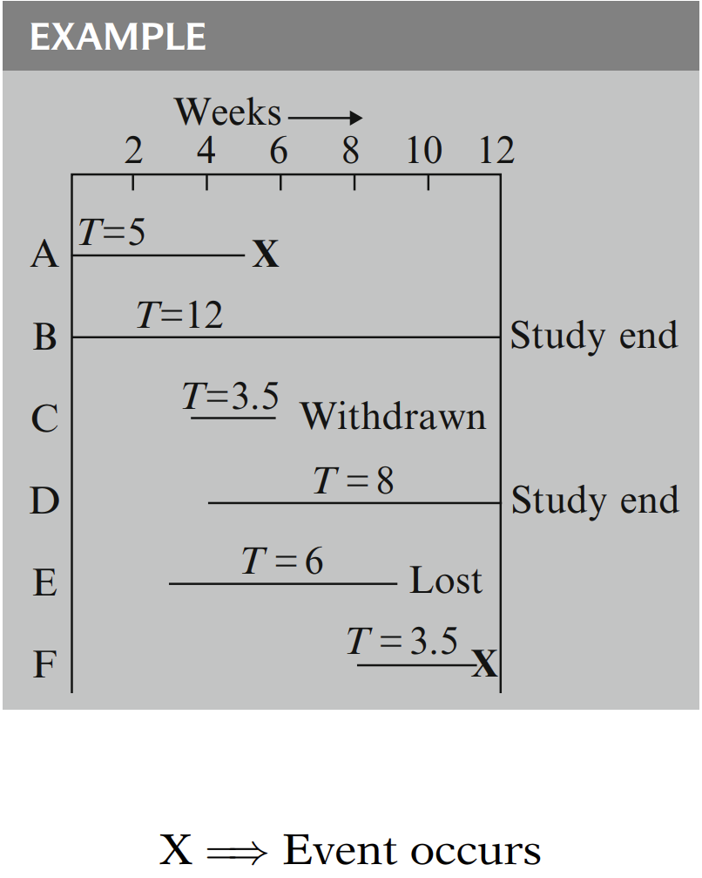
Censored Data
Censoring: incomplete information about survival
Three reasons why censoring occurs:
  (1) study ends, (2) loss to follow-up, and (3) withdraw from study

Slide 16

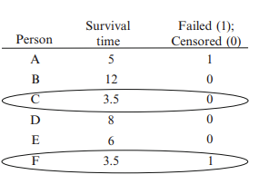
Summary Table (Censored: B, C, D, E)

Slide 17
Non-informative Censoring (Key Assumption)
The reason a participant is censored is unrelated to their risk of experiencing the event of interest
Patient moves to another city for new job
Study ends before the patient experiences the event
The reason for censoring are not associated with event risk (disease severity or treatment failure)

Slide 18
Informative Censoring (Violation of Assumption)
.
A.
Occurs when the reason for censoring is related to the event risk:
Patient stops coming to follow-ups because their cancer recurred
Sicker patient drops out of the study
Why It Matters: If the assumption is violated, the estimated survival probabilities may be biased
How to Check: review censoring reasons, compare baseline characteristics

Slide 19
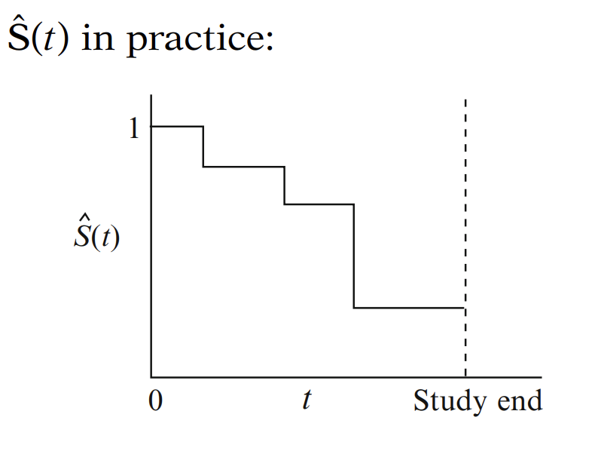
Survivor Function
S(t) = P(T > t): probability of survival past time t
Properties of survivor function, S(t):
  (1) Step function, decreases from S(t) = 1 at t=0
  (2) S(t) = 0 at t=end of study, if everyone in study experience the event of interest

Slide 20
Types of Censoring
Right censoring: event not observed within study period (most common)
Left censoring: event occurred before observation started
Interval censoring: event occurred between two observations
Administrative censoring: study ends before event occurs

Slide 21
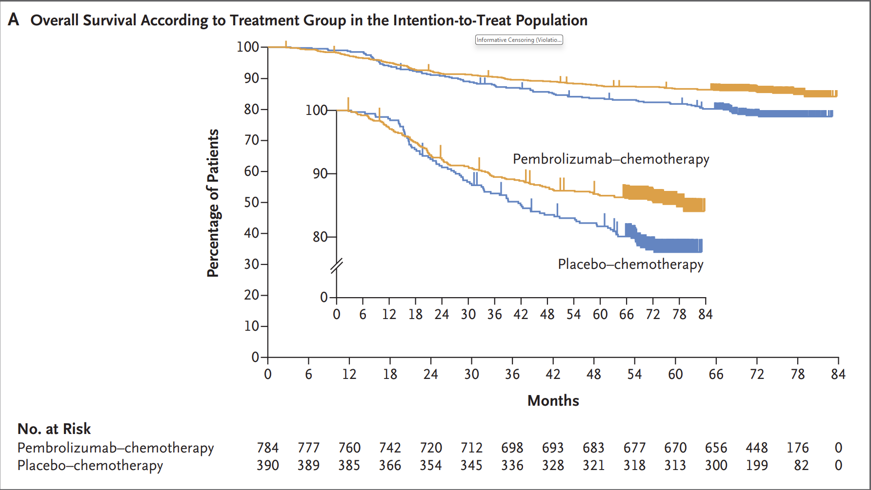
Kaplan Meier Curves

Slide 22
Hazard Function
h(t) : hazard rate, instantaneous death rate, conditional failure rate
Defined as the instantaneous rate of the event given that an individual has survived up to time t
Hazard function is not a probability
Hazard rate often likened to velocity

Slide 23
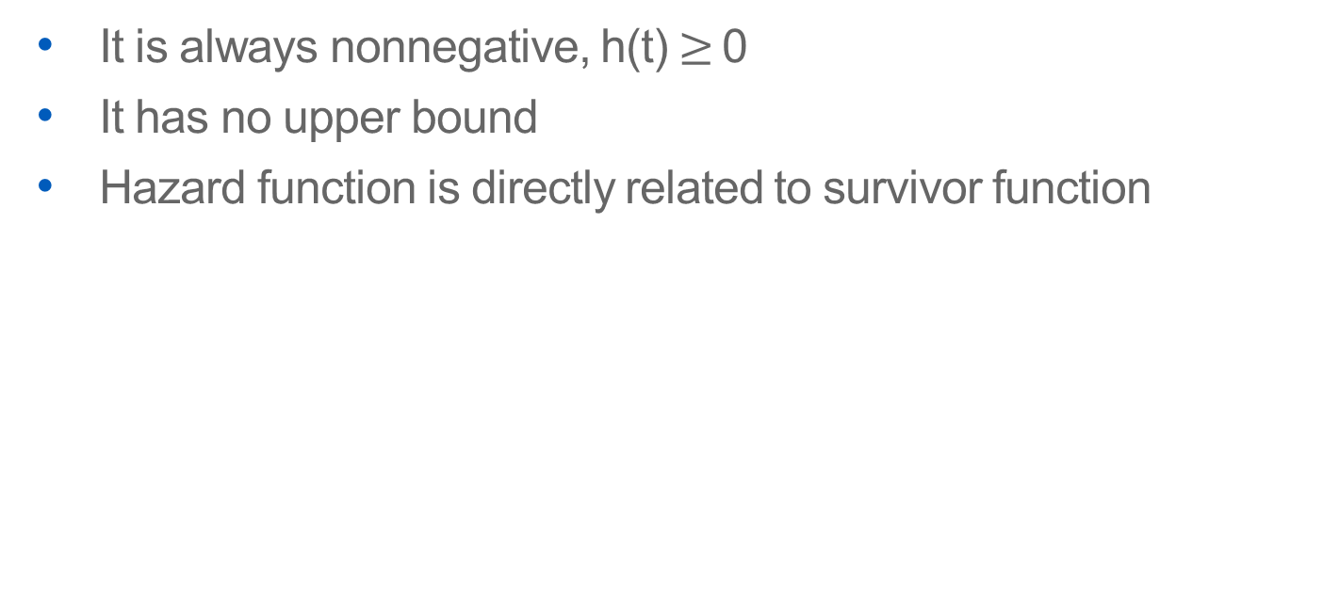
Properties of Hazard Function
It is always nonnegative, h(t) $≥$0
It has no upper bound
Hazard function is directly related to survivor function

Slide 24
Hazard Functions in Medicine
Constant hazard: The risk of event per unit time does not change, regardless of how long the patient has survived (e.g., sudden cardiac death in high-risk heart failure patients)
Increasing hazard: Risk worsens over time—may suggest progressive, degenerative, or aging-related disease processes (e.g., risk of death increases with age)
Decreasing hazard: Event risk is front-loaded and declines with time as recovery or stabilization occurs (e.g., complications after surgery are highest right after)
Bathtub-Shaped Hazard (e.g., chemotherapy or transplant)
Unimodal Hazard (e.g., risk of recurrent stroke peaks within 30 days, then decreases)

Slide 25
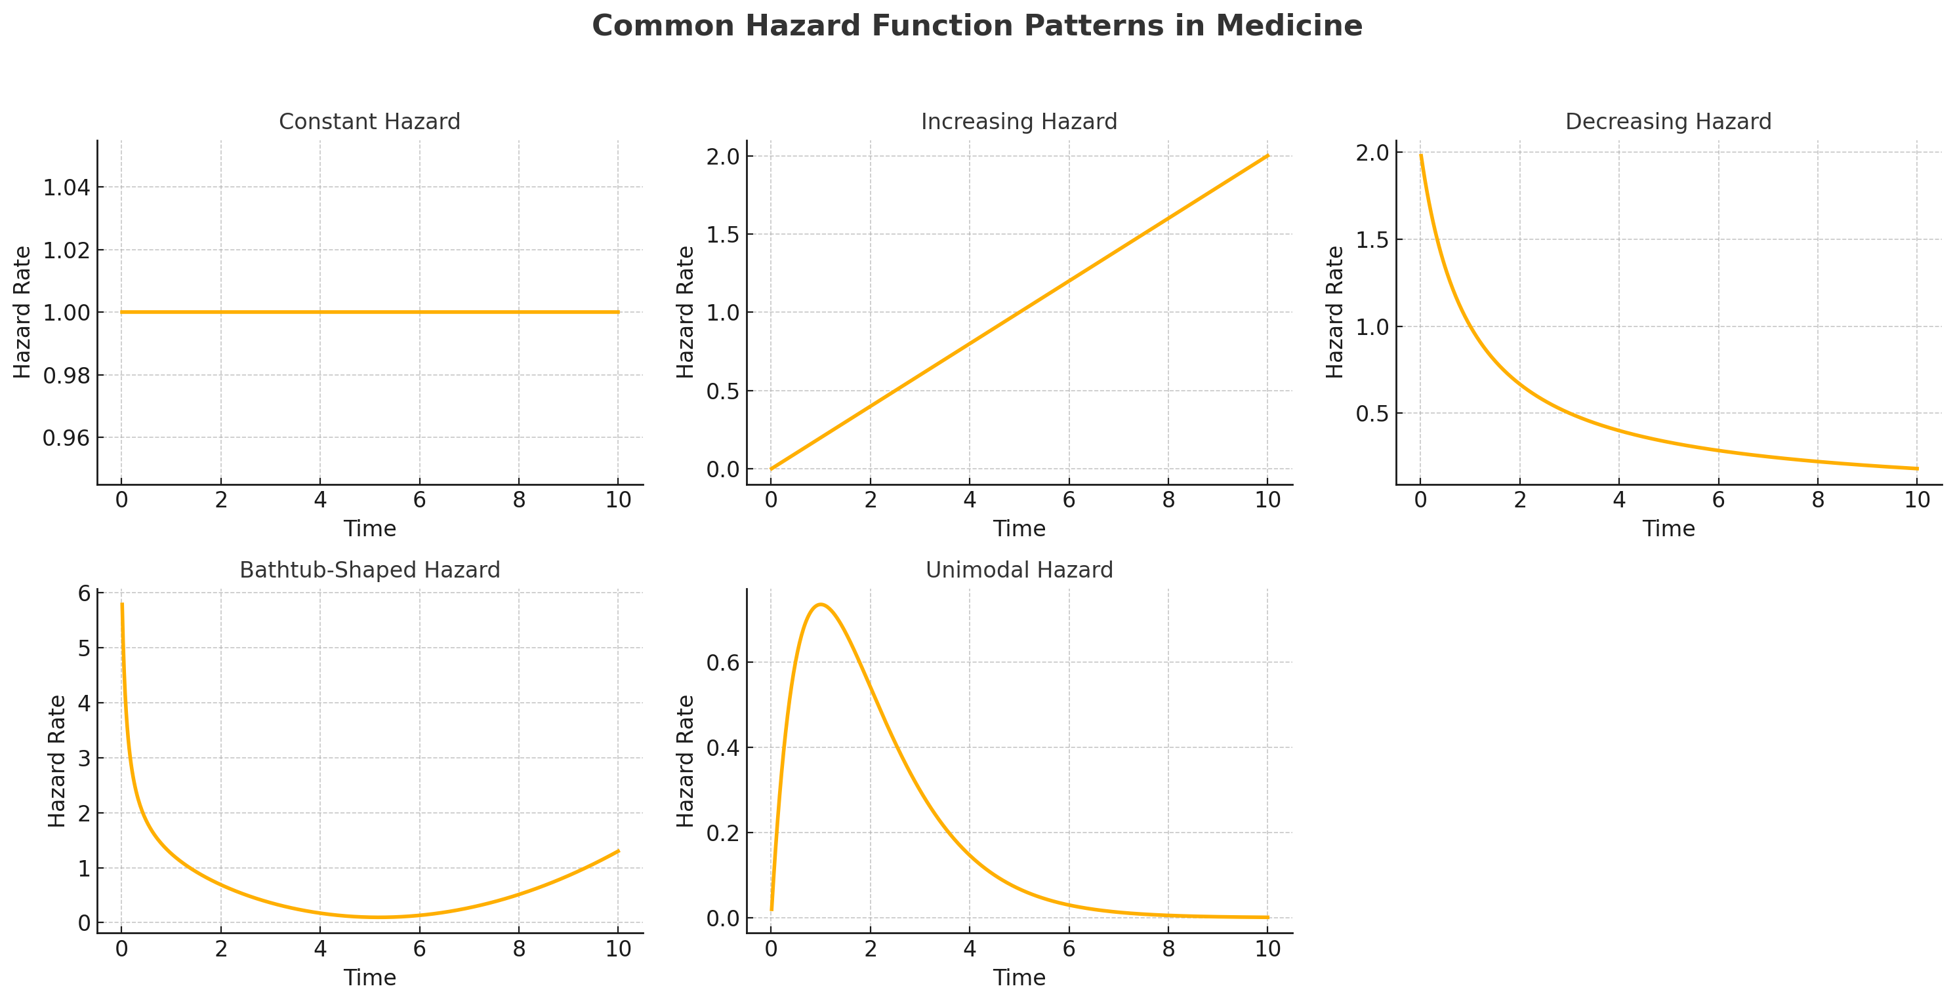

Slide 26
Goals of Survival Analysis
To estimate and interpret survivor and/ or hazard functions from survival data
To compare survivor and/or hazard functions
To assess the relationship of explanatory variables to survival time

